Slide 1



INTELLIGENT COMPANION ROBOT:
AN AUTONOMOUS ROBOT FOR REAL-TIME TARGET TRACKING AND INTERACTIVE VOICE ENGAGEMENT
Group Members
1. UMARU _ 12431495
2. 江炜韬 _ 12431497
3. KHOWAJA _ 12431493
4. 朱俊希 _ 12432460

Slide 2
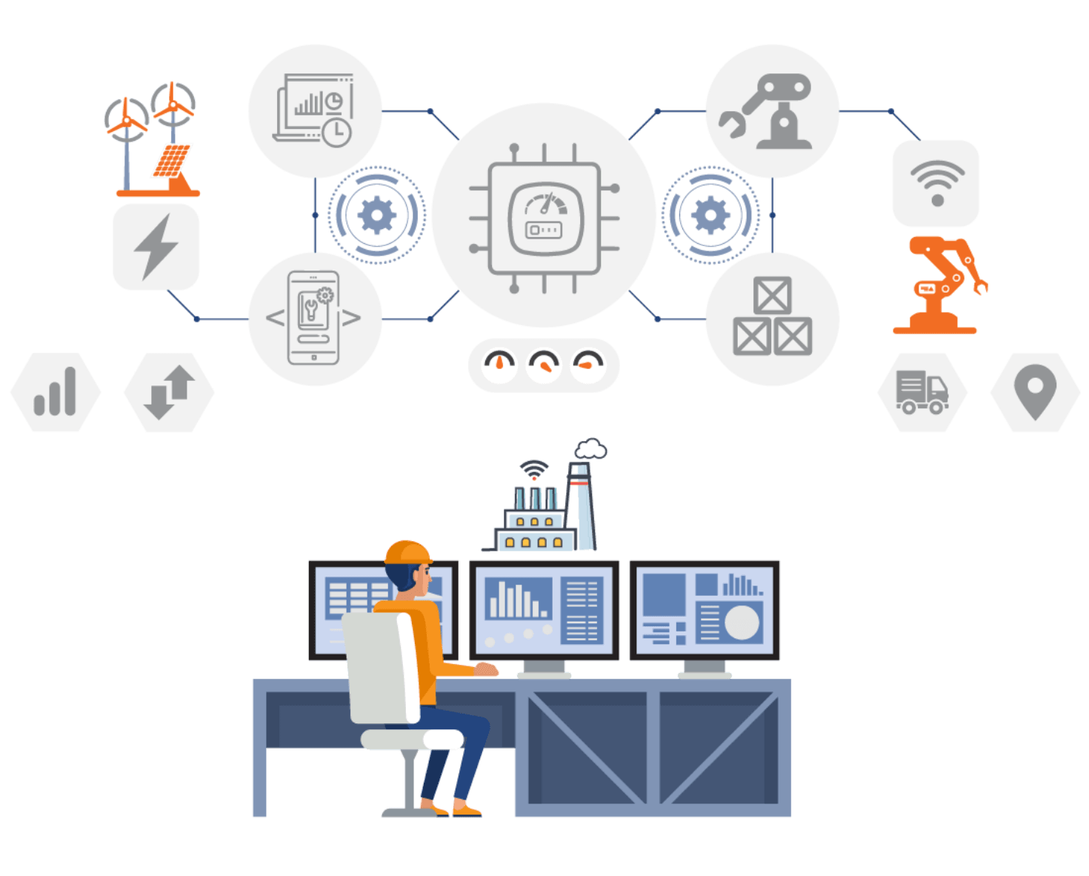
AGENDA
Project Introduction
Technological Feasibility & Innovation
Hardware Architecture
Market Demand & Competitive Analysis
Design & Development
Performance & Future Roadmap

Slide 3
1. Project Introduction
Background
The convergence of AI, robotics, and IoT has revolutionized interactive systems design.
These technologies enable machines to process natural language, recognize visual patterns, and navigate autonomously.
This technological integration creates new possibilities for intelligent assistants in dynamic environments.
Product Overview
Intelligent Companion Robot: Autonomous AI-driven system for real-time tracking and voice interaction
Combines visual recognition, natural language processing, and autonomous mobility
Features:
High-resolution camera system
Microphone arrays and speaker systems
Obstacle detection and navigation
Onboard processing and cloud connectivity

Slide 4
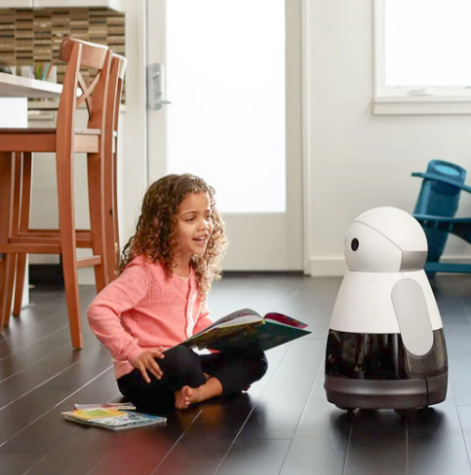
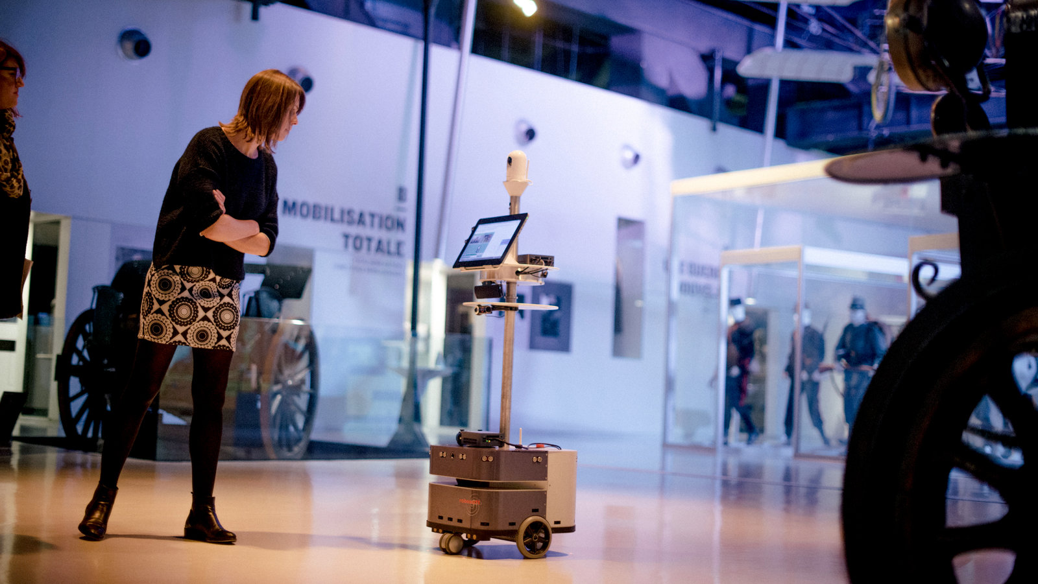
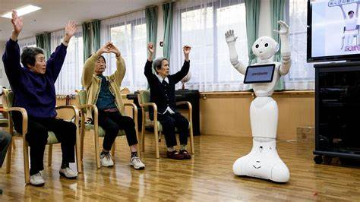
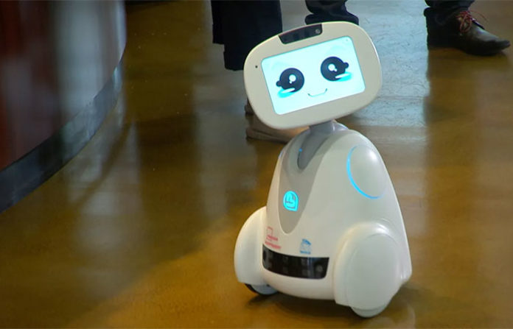
1. Project Introduction
Applications
Retail: Customer navigation assistance, product information, inventory monitoring
Cultural: Museum guides with multilingual exhibit information
Home: Personal assistant for daily tasks and elderly companionship
A robot at the Musée de la Grande Guerre, or the Museum of the Great War, in Meaux, France, about 30 miles east of Paris.Credit...Dmitry Kostyukov for The New York Times
Companion robot for elderly home (Elderly Assistance Robotics)
https://roboticsbiz.com/top-5-best-robot-personal-assistants-for-your-home-in-2019/
Robot companion for home/personal assistance
https://www.nytimes.com/2017/03/14/arts/design/museums-experiment-with-robots-as-guides.html
https://provenrobotics.ai/talking-robot-assistant/

Slide 5
2. Technological Feasibility & Innovation
Key Technologies
Visual Recognition: High-resolution camera with CNN/RNN algorithms for real-time tracking
Voice Interaction: Microphone array with NLP models (BERT/GPT) for natural language understanding
Autonomous Mobility: Mobility chassis with LiDAR/ultrasonic sensors for navigation
Deep Learning Algorithms
CNN Models: YOLO/SSD for object detection and classification
RNN Models: LSTM for temporal tracking and movement prediction
Performance: High accuracy in tracking with real-time response capabilities
Voice Recognition & NLP
Voice Recognition: Uses HMMs or DNNs for speech-to-text conversion
Natural Language Processing: Pre-trained models for intent recognition and response generation
Capabilities: Supports multiple languages and complex dialogue management

Slide 6
3. Hardware Architecture
Core Components
Camera Module: Seeed Studio XIAO ESP32S3 Sense with integrated camera
Sensing Module: RPLIDAR A1 for 2D mapping + HC-SR04 ultrasonic sensor for obstacle detection
Mobility Chassis: Dagu Wild Thumper 6WD for robust movement
Microcontroller: Seeed Studio XIAO ESP32S3 for processing and control
Audio System: ReSpeaker 4-Mic Array and Adafruit I2S 3W Class D Amplifier
Integration
Central Processing: Microcontroller coordinates all sensor inputs and outputs
Communication Protocols: I2C for microphone array, PWM for motor control
Power Management: Designed for efficient operation across all components

Slide 7
4. Market Demand & Competitive Analysis
Market Demand
Retail: Guided navigation in malls improves shopping experience
Cultural: Interactive museum guides enhance visitor engagement
Home: Elder care companions address ageing population’s needs
Security: Patrol robots for campuses, airports, and markets
Competitive Landscape
SoftBank Robotics Pepper: Strong social interaction but expensive and limited mobility
Anki’s Cozmo: Excellent facial recognition but limited real-world navigation
Amazon’s Astro: Robust connectivity but limited market penetration
Our Advantage: Low-cost hardware with high-end software capabilities

Slide 8
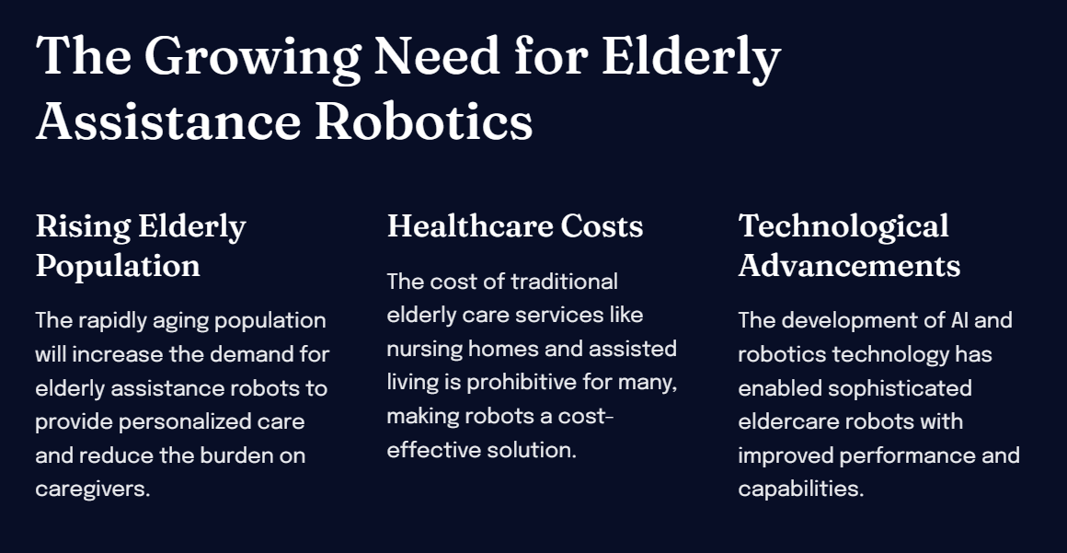
Market Research on Elderly Assistance Robotics
https://gamma.app/public/Market-Research-on-Elderly-Assistance-Robotics-m1fn4lgi2rvxn6u?mode=doc

Slide 9
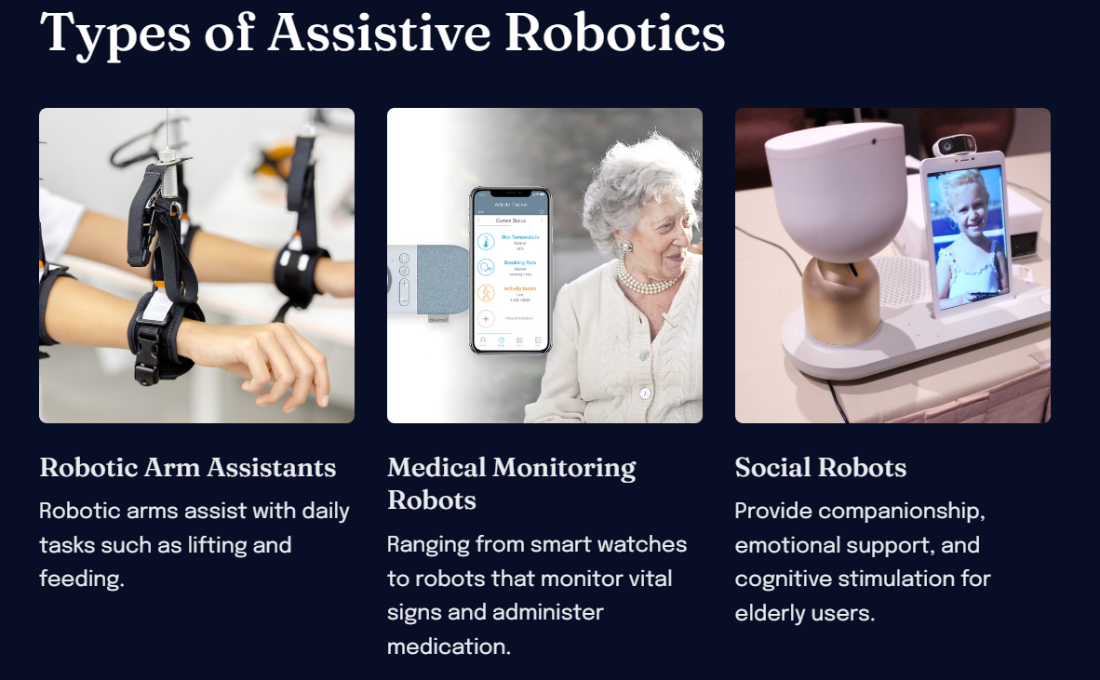
Market Research on Elderly Assistance Robotics
https://gamma.app/public/Market-Research-on-Elderly-Assistance-Robotics-m1fn4lgi2rvxn6u?mode=doc

Slide 10
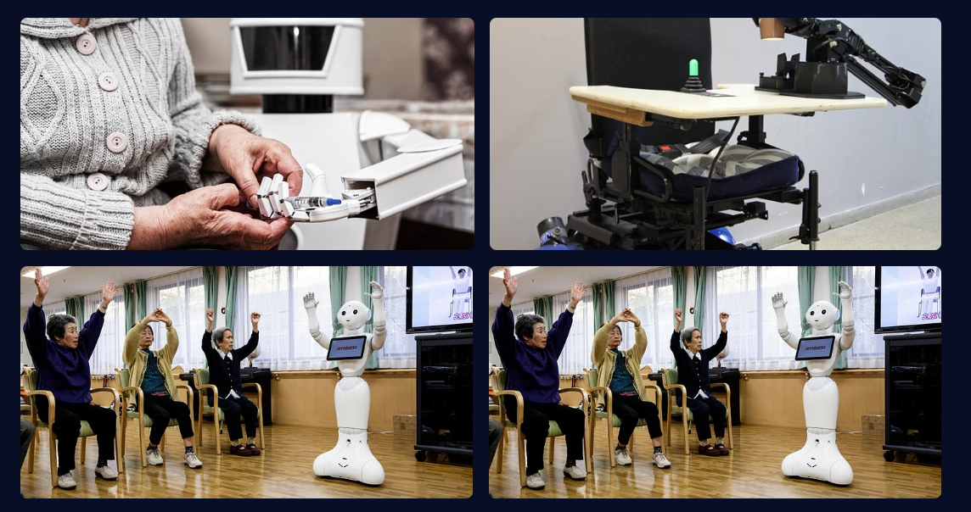
Market Research on Elderly Assistance Robotics
https://gamma.app/public/Market-Research-on-Elderly-Assistance-Robotics-m1fn4lgi2rvxn6u?mode=doc

Slide 11
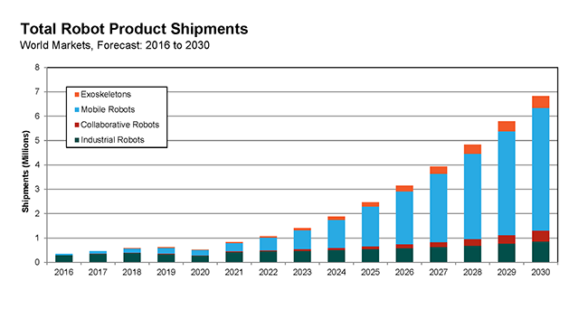
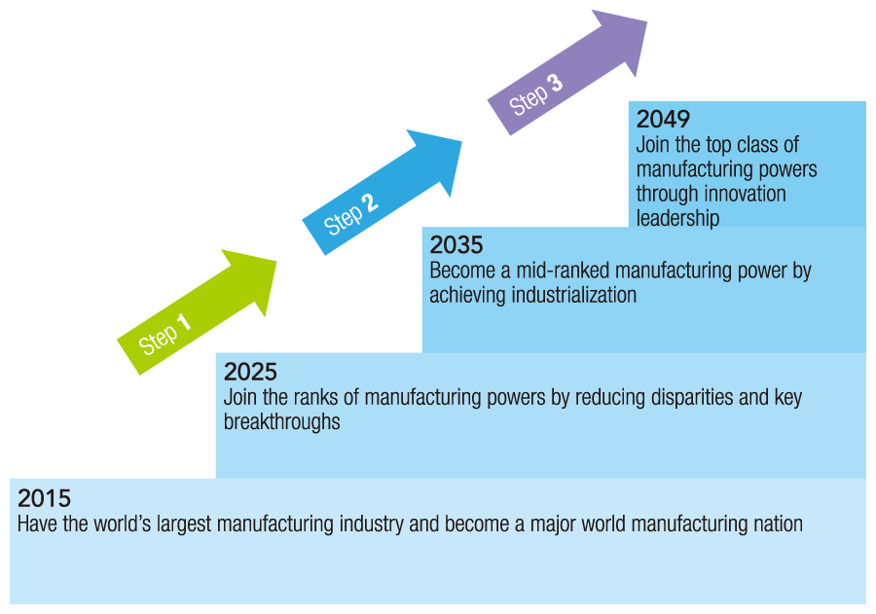
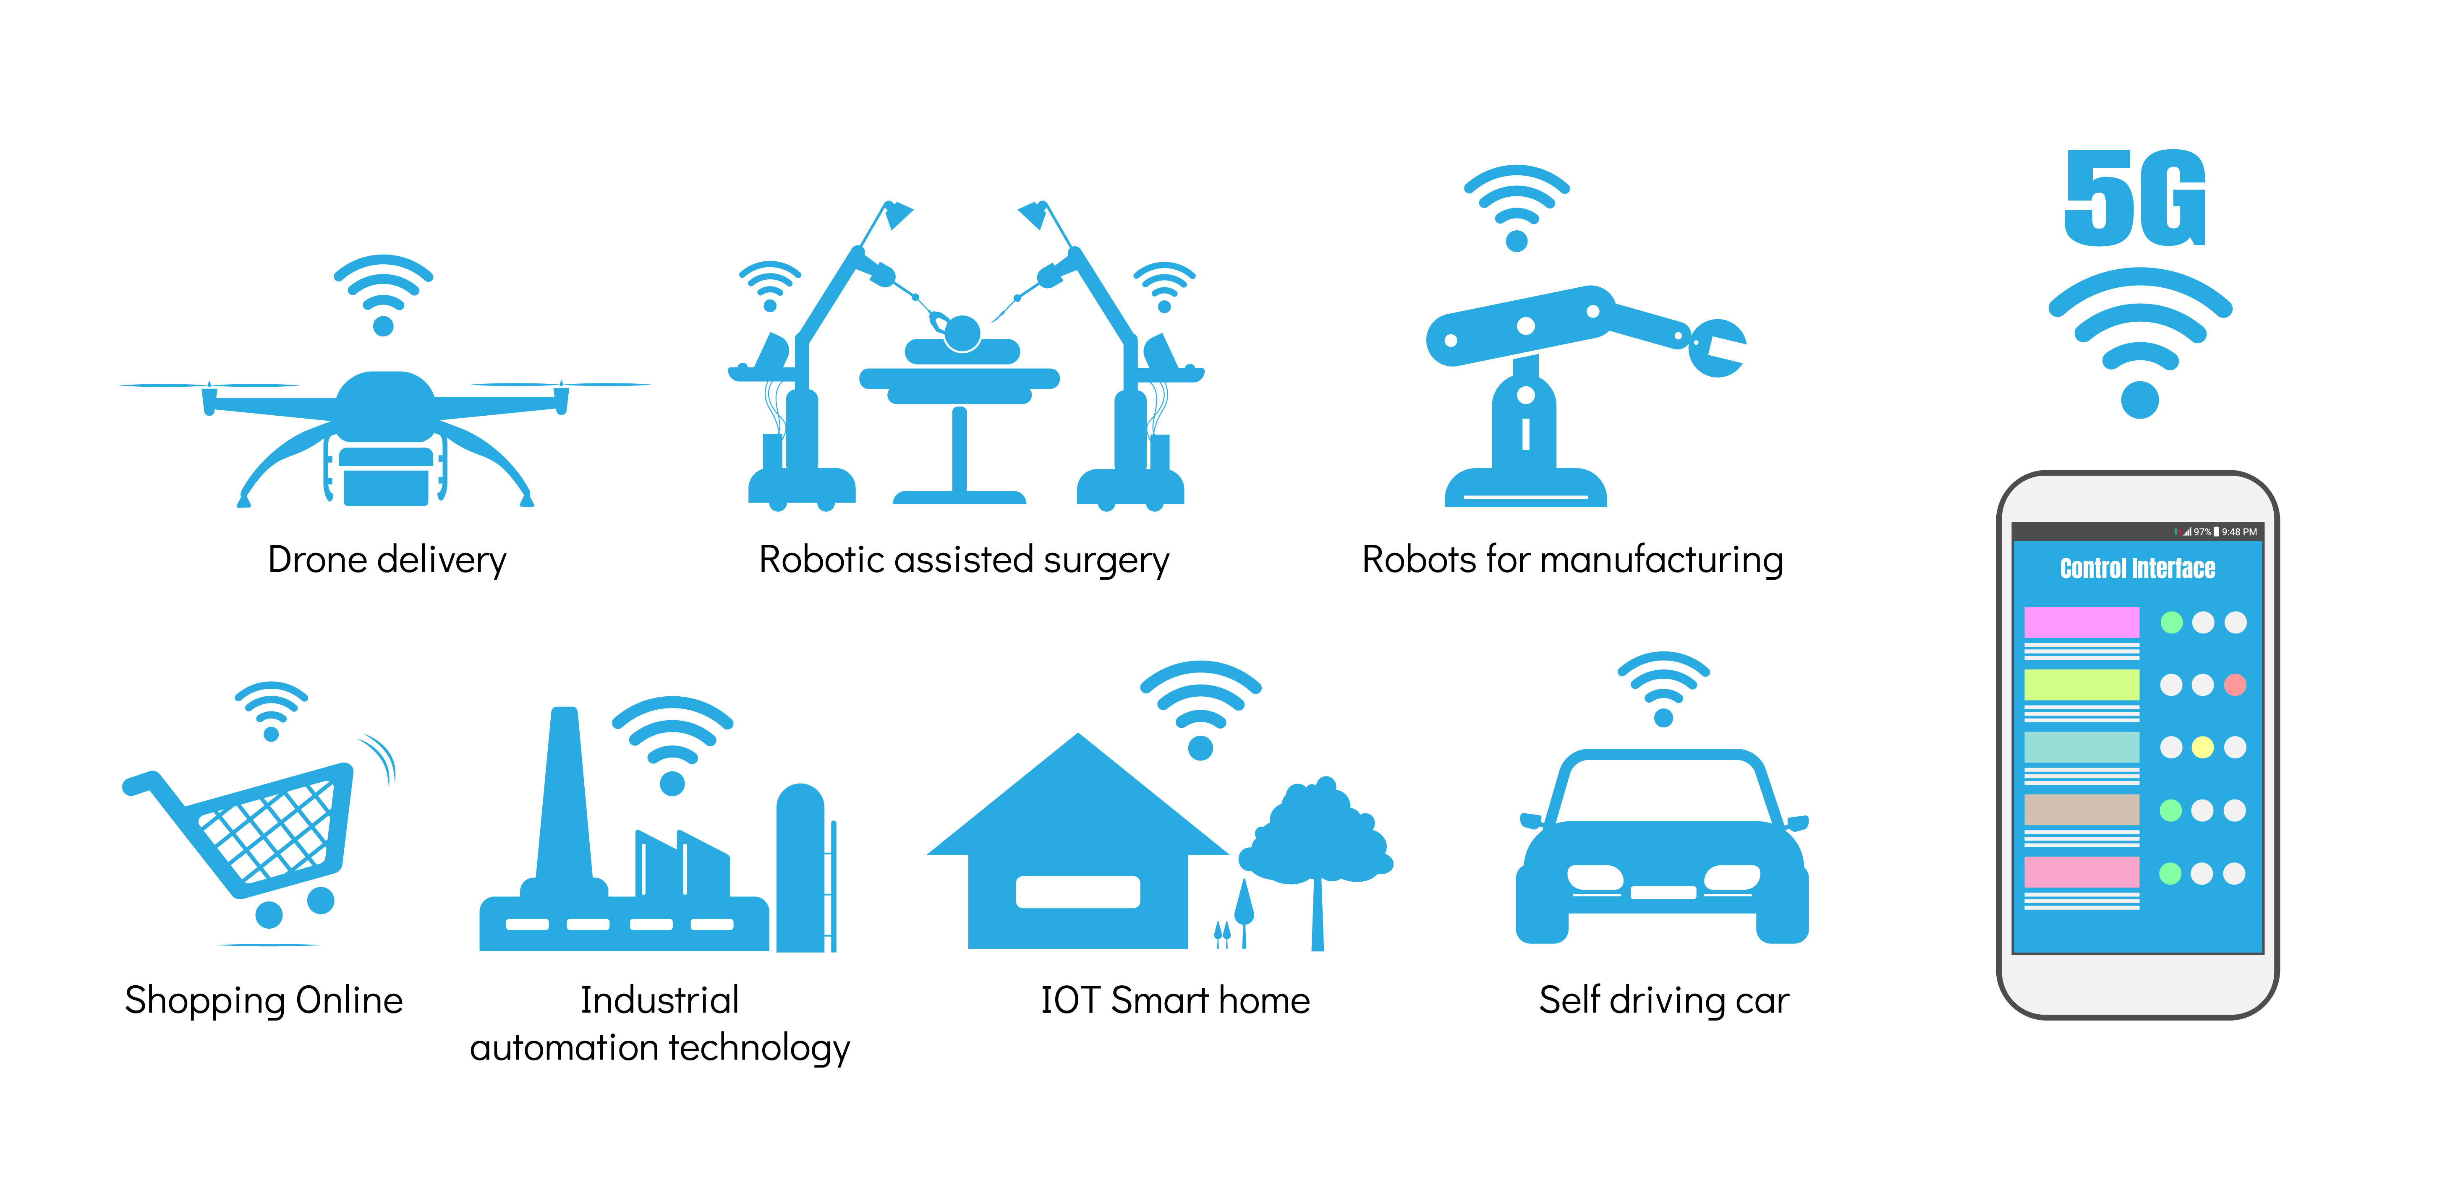
Industry Trends and Market Potential – What’s Next?
https://www.automate.org/industry-insights/industry-trends-and-market-potential-what-s-next
https://www.hitachihyoron.com/rev/archive/2018/r2018_02/gir/image/fig_03.pngc
https://cdn2.hubspot.net/hubfs/3974501/5gio%20(1).png

Slide 12
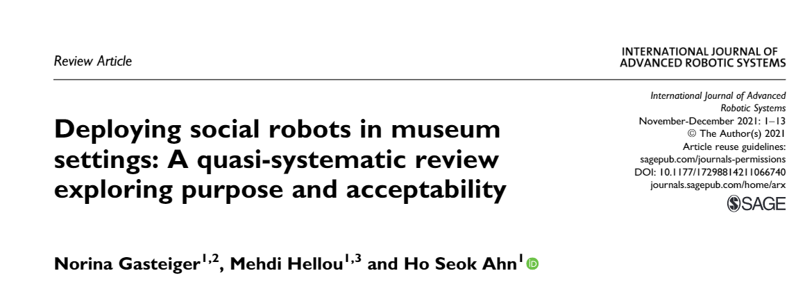
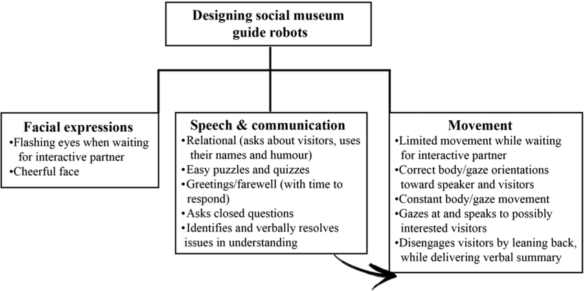
1. Project Introduction
https://www.researchgate.net/publication/357274441_Deploying_social_robots_in_museum_settings_A_quasi-systematic_review_exploring_purpose_and_acceptability

Slide 13
5. Design & Development
Task Allocation
Hardware Engineers: Sensor integration, camera setup, mobility systems → 朱俊希 _ 12432460
Software Developers: Algorithm development, voice recognition, navigation → KHOWAJA _ 12431493
AI Specialists: Deep learning models, NLP frameworks →江炜韬 _ 12431497
Project Managers: Timeline, resource allocation, risk management → UMARU _ 12431495
Appearance & Structure
Ergonomic Design: User-friendly with intuitive interfaces
Robust Chassis: Supports movement across various terrains
Visual Appeal: Streamlined appearance for public environments
Function Development
Real-Time Tracking: Pre-trained models for accurate object detection
Voice Interaction: State-of-the-art NLP for natural conversations
Autonomous Navigation: Sensor fusion with path-planning algorithms

Slide 14
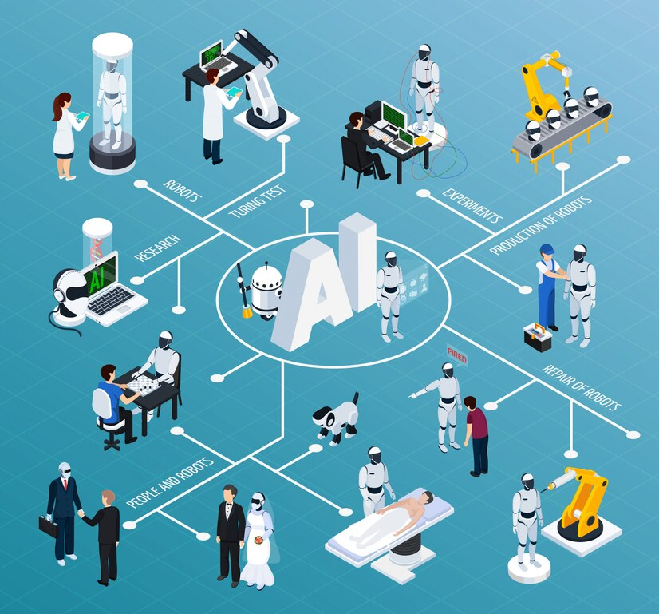

6. Performance & Future Roadmap
Prototype Performance
Accuracy: High precision in target tracking
Response Time: Swift interactions in voice commands
User Feedback: Positive reception in controlled environments
Future Roadmap
Model Optimization: Improve deep learning efficiency
Expanded Interactions: Add gesture and tactile interfaces
Field Testing: Deploy in real-world environments for further refinement
Scalability: Develop versions for different market segments

Slide 15
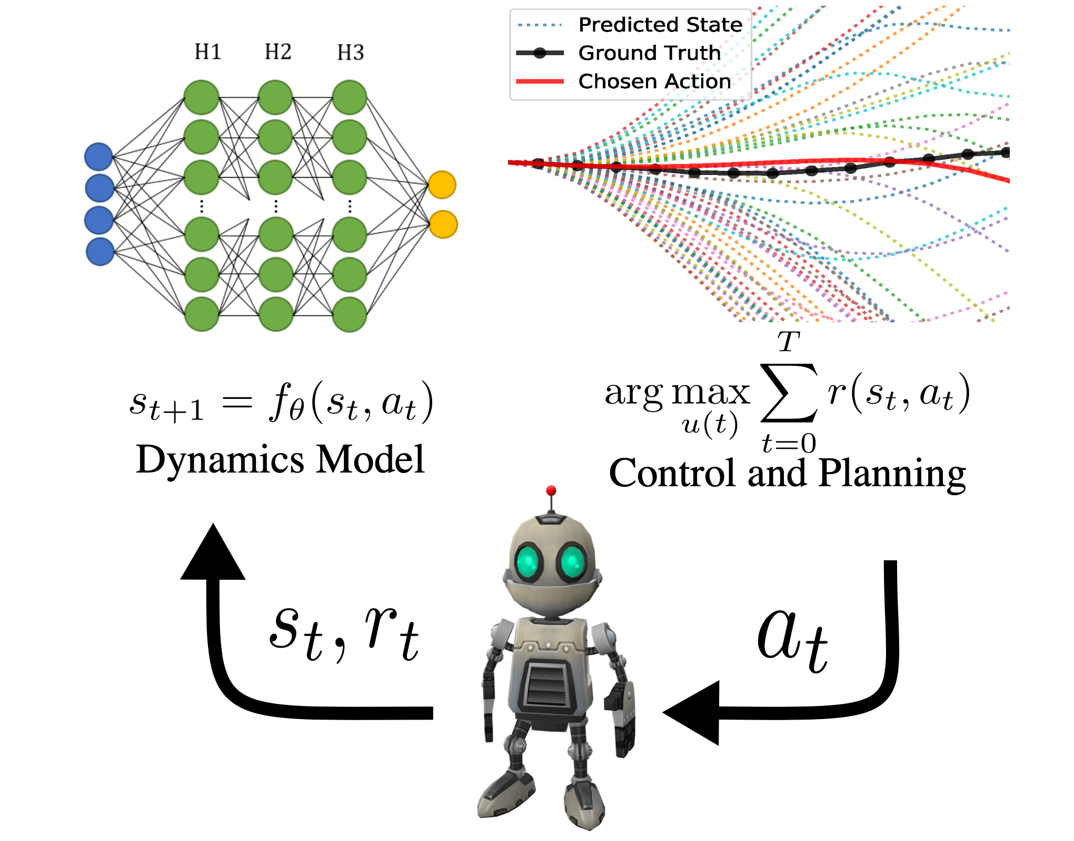

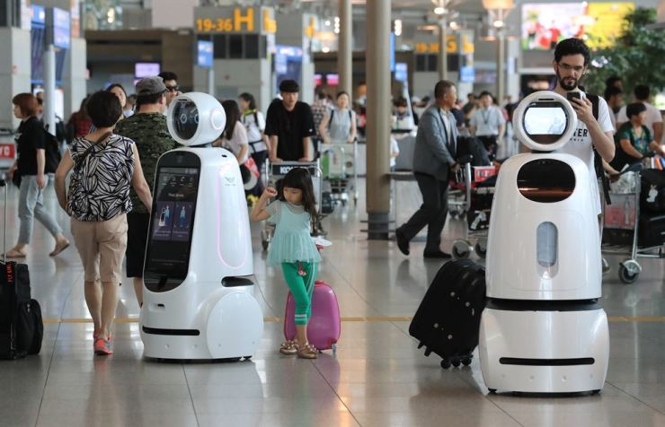
Conclusion
In conclusion, modern Chinese achievements in intelligent manufacturing and robotics reflect a blend of visionary policies, cutting-edge research, and industrial commitment.
As we move forward, these innovations will transform China and inspire global technological advancements.

